Slide 1

CHUNGHWA TELECOM
PROGRAMMING DESIGN AND APPLICATIONS
Jérôme DAULION - X1070076
Elisa GRESSIER-MONARD - X1070077
Romain MOINEAU - X1070079
Karel KEDEMOS - X1070078
Wednesday 12th June
Notes:
Karel

Slide 2
CONTENTS
IDEATION REMIND
USES CASES AND SEQUENCE DIAGRAMS
HAND DRAWN SKETCH
BUILD CODE
PROTOTYPE
Notes:
elisa

Slide 3
WHAT WAS THE IDEA ?
Documents are immediately accessible and stored
Only particular documents will be stored online
No document loss
Documents keep their legal value
Possibility of keeping the original mail in a PO box
Notes:
romain

Slide 4
II. USE CASES
Notes:
elisa

Slide 5
On the list
“include”
Scan the document
“include”
Document storage by Chunghwa
Upload on dropbox
“extends”
”
“include”
Registered
“include”
Verify if the document is on the list
“extends”
”
Send an email to the user to notify him
1
1..*
“include”
Receive the document
Check if the recipient is registered
1
“extends”
”
1
Not on the list
“extends”
”
Postman
User
Unregistered
“include”
“include”
Put the document in the delivery box

Slide 6
Document storage by Chunghwa
Chunghwa Client with a PO
Dropbox
Document list
Post
Is the document on the list ?
the document is not on the list
Scan the document
upload on Dropbox
send an email to notify

Slide 7
Website utilization
Authentification
Access to a document
1
1
“include”
“include”
Choose a folder
Chungwa
“extends”
”
Customer
“extends”
”
Send the document
“extends”
”
“extends”
”
Delete the document
Print the document
Ask for destroying the original
1
1..*
Operator
“include”
Confirmation code by phone message

Slide 8
Modification by the customer on the website
Website
Security
Database
Post storage
Authentification
Captcha
Authentification
Connected
Succesful Authentification
Check for the user
Dropbox Security
Access dropbox
Dropbox accessed
Success
Choose a folder
Find folder
Charge the folder
Folder entered
Folder information
Choose a document
Find document
Document chosen
Document information
Charge the document
Destroy document
Send notification to operator
Document being destroyed
Document destroyed
Modification appears
Update document status

Slide 9
Website utilization with detailed document section
Access to a document
Authentification
1
1
“include”
“include”
Others
Chungwa
“include”
Choose a folder
Customer
“include”
Certificates
“extends”
”
“extends”
”
“extends”
”
“include”
Delete the document
Factures
Print the document
Ask for destroying the original
“include”
Others
“include”
“include”
“include”
Water
Gas
Electricity
“include”
Confirmation by phone message

Slide 10
III. HAND DRAWN SKETCH
Notes:
elisa

Slide 11
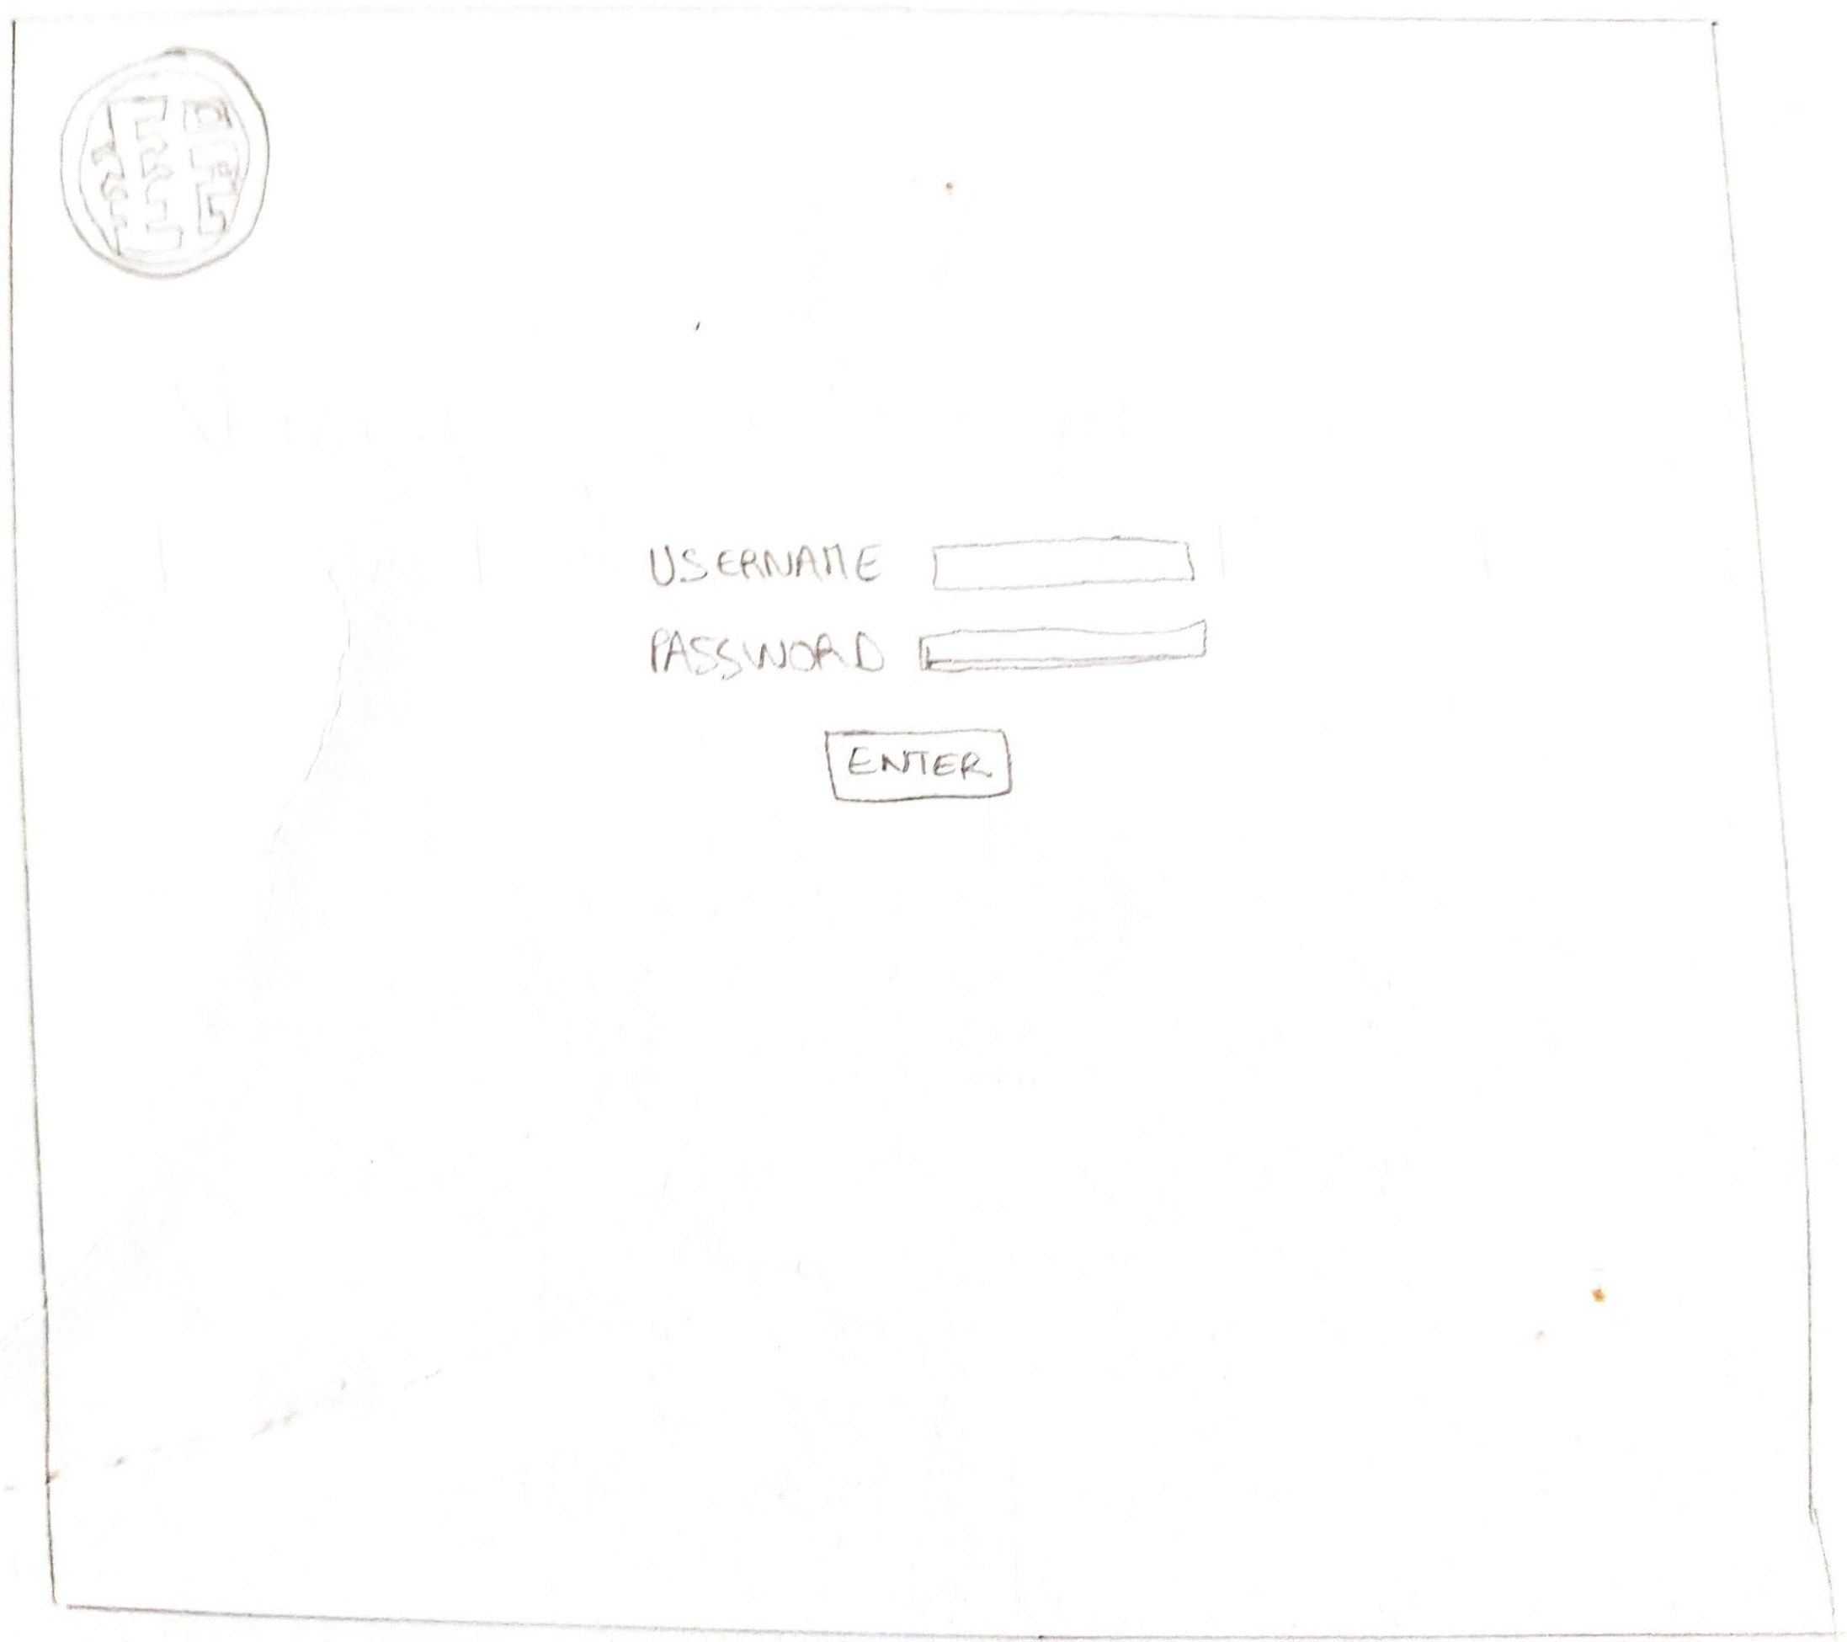

Slide 12
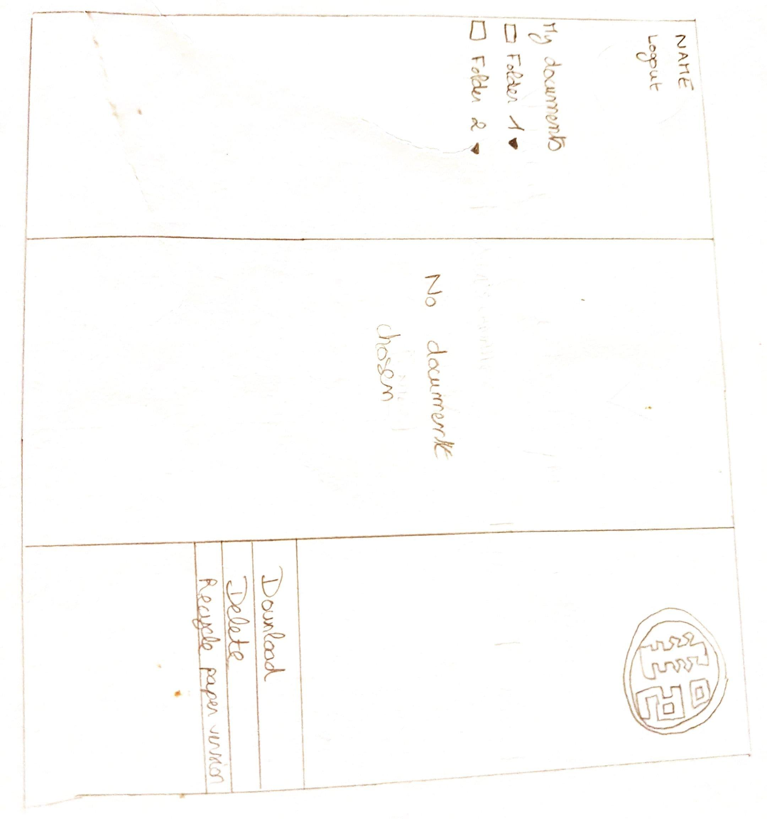

Slide 13
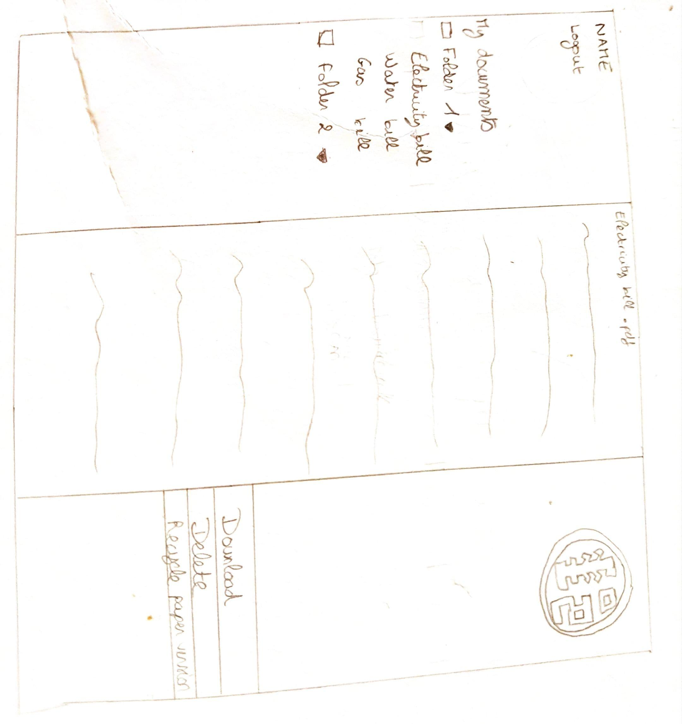

Slide 14
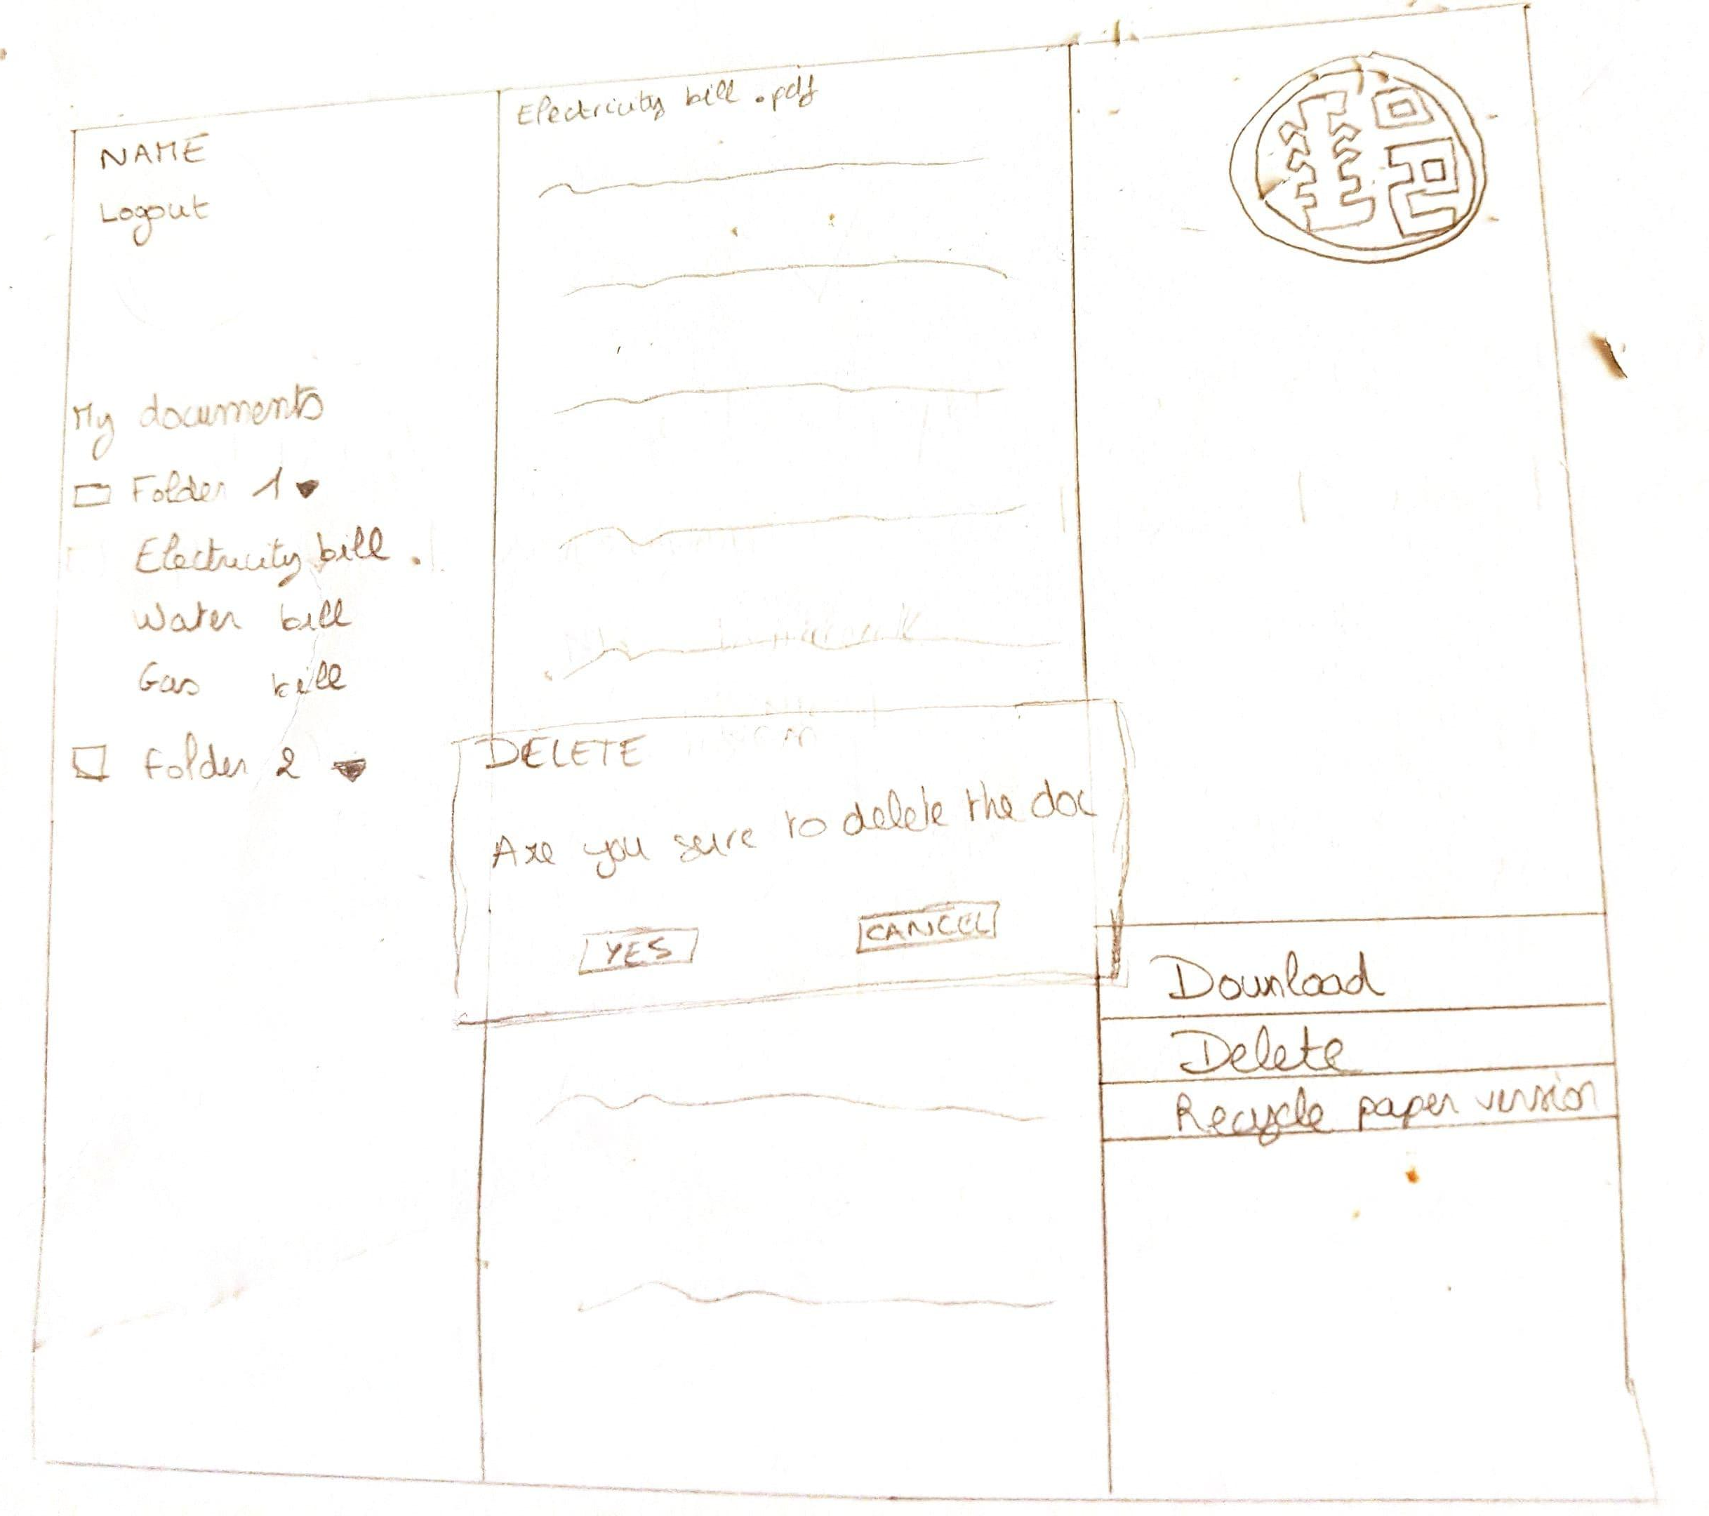

Slide 15
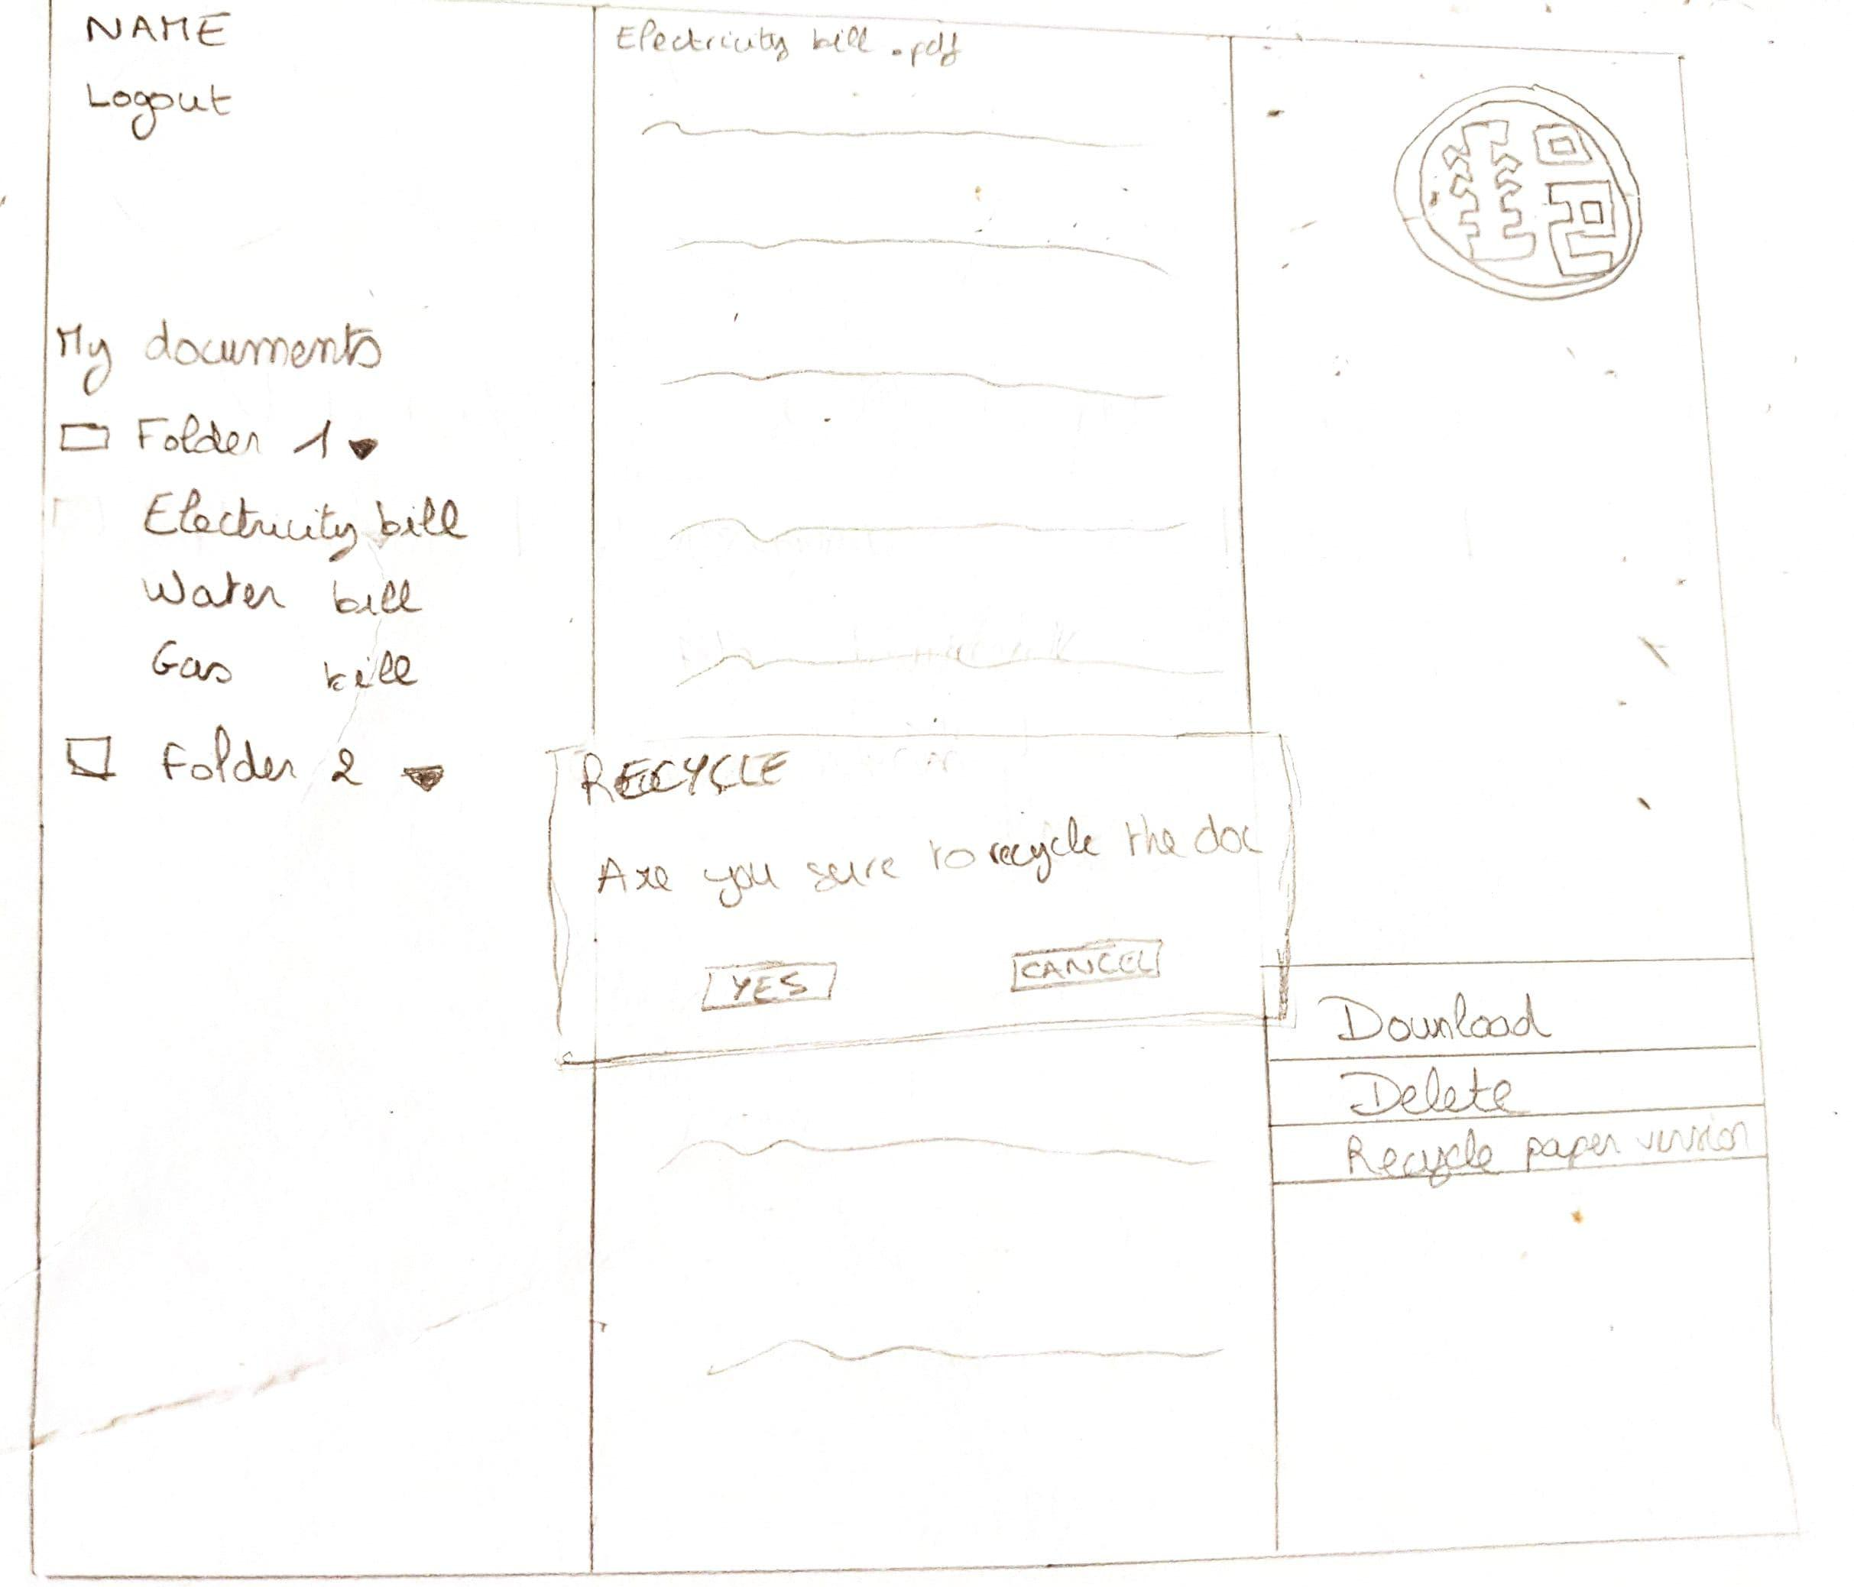

Slide 16
IV. BUILD CODE
Notes:
elisa

Slide 17
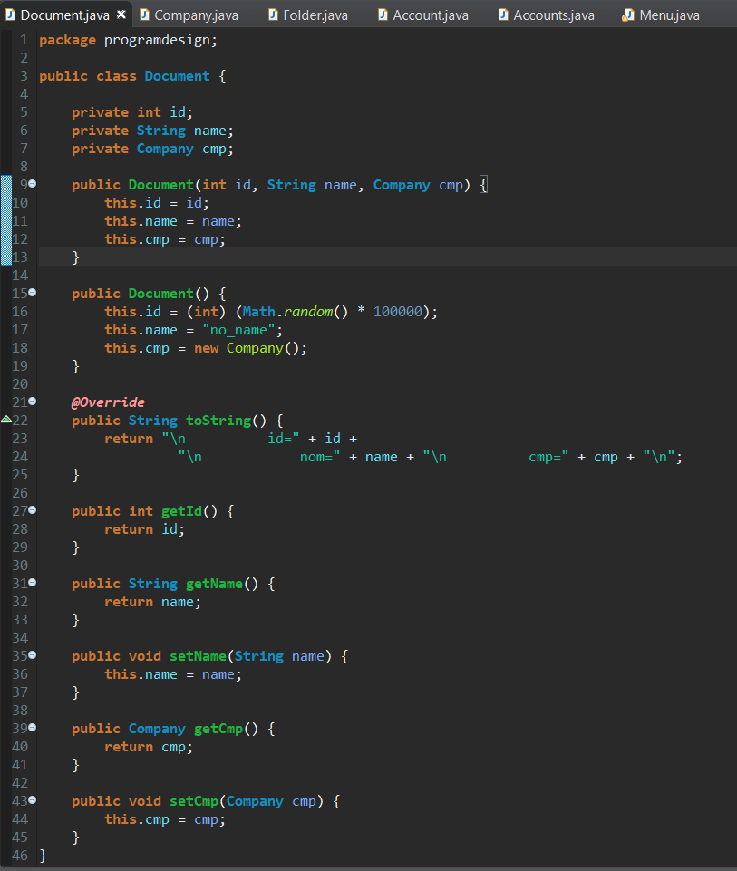
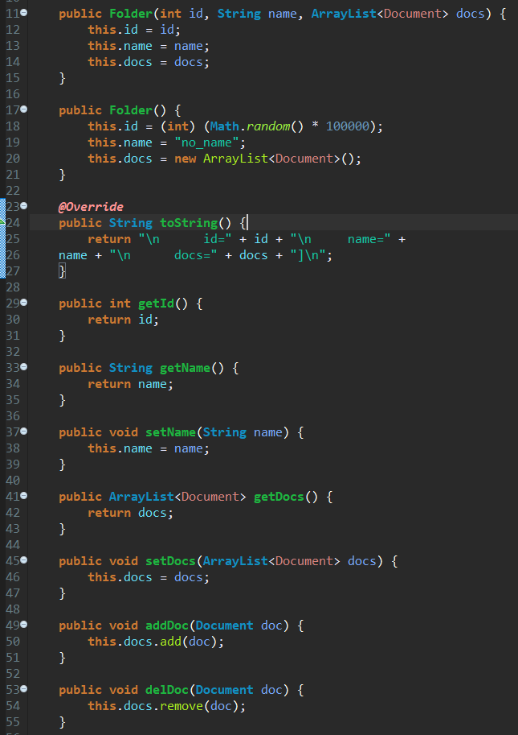
BUILD CODE
Notes:
romain

Slide 18
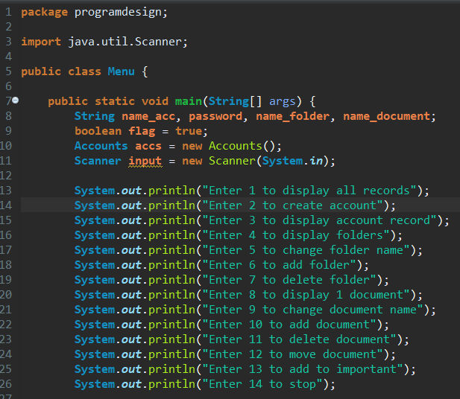
Menu

Slide 19
V. PROTOTYPE
Notes:
elisa

Slide 20
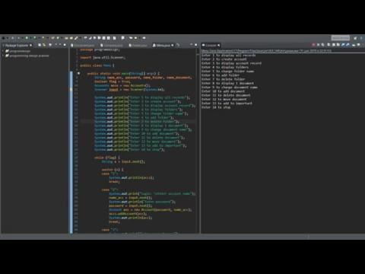
Demo

Slide 21

Demo Site

Slide 22
Future Improvements
Improve the website ergonomy and more functionalities
Store the information on the user’s device
Code everything with PHP to have the dynamic part with the HTML
Write everything in chinese
Add a function to ask the post to send the document (with a pay function)
Notes:
romain

